Slide 1


Real-Time Sign Language Translator Using ML & OpenCV
Group members: Danyal /Arsh /Shivam /Malhar
Review on Real-Time Sign Language Detection Using TensorFlow and OpenCV

Slide 2
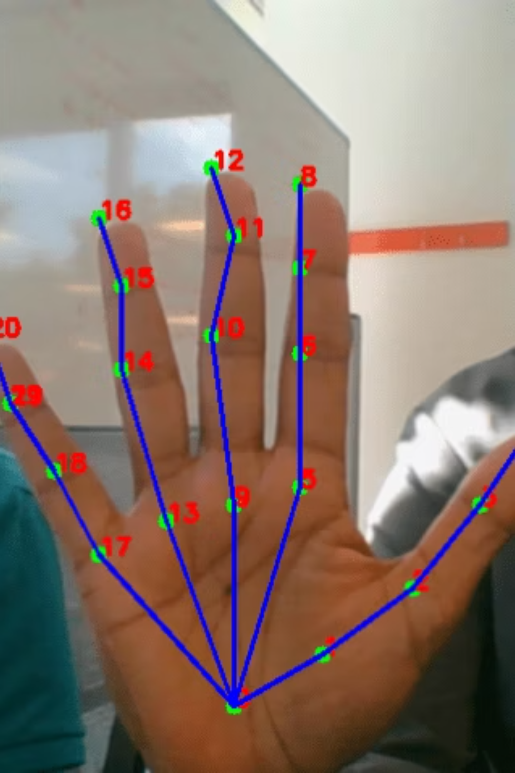
1. Introduction
The implementation of real-time sign language detection systems bridges the communication gap between the hearing-impaired and the hearing population. The reviewed paper proposes a cost-effective, camera-based system using image processing and machine learning, particularly leveraging the SSD MobileNet V2 architecture for hand gesture recognition.

Slide 3


2. Key Techniques and Components
2.1. Contrast Image
The system ensures high-contrast imaging for effective hand segmentation. The importance of contrast is emphasized in enabling the model to distinguish the hand region from the background. Techniques like adaptive thresholding and binary conversion are applied post-hand segmentation to enhance contrast.
2.2. Black Background
To maximize recognition accuracy, the model was trained and tested under controlled environments, often using plain black or dark-colored backgrounds. This simplification helps eliminate background noise and improve hand detection.
2.3. White Hand / Hand Color Detection
The datasets were collected using webcams, ensuring that hand color was distinguishable against the background. Skin color segmentation or manual HSV-based filtering helped in isolating hands. In some referenced methods, background subtraction and hand masking techniques are used for better detection.

Slide 4
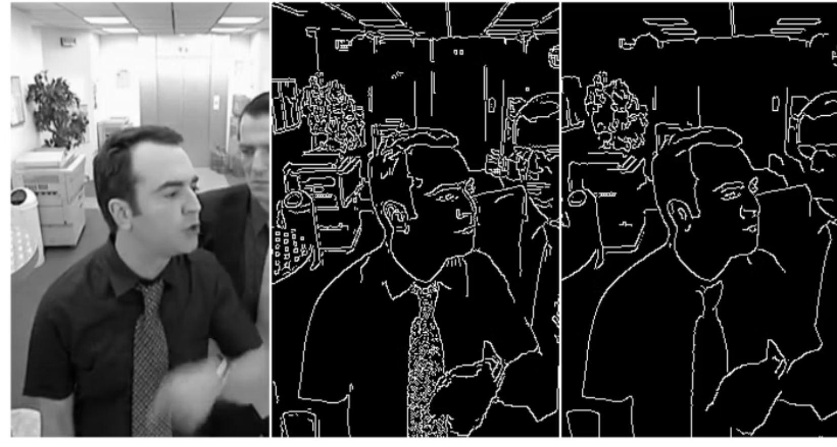
3. Image Processing Techniques
3.1. Edge Detection
Edge detection plays a crucial role in identifying the outline of hand gestures. Although not a primary method in the current model, prior works referenced in the paper included techniques like:
Canny Edge Detection
Hough Transform These help refine gesture contours, especially in low-contrast scenarios.
3.2. Morphological Operations
To improve binary images, operations like erosion, dilation, and blurring were used. These clean up noise and enhance the finger outlines, improving model input quality.

Slide 5

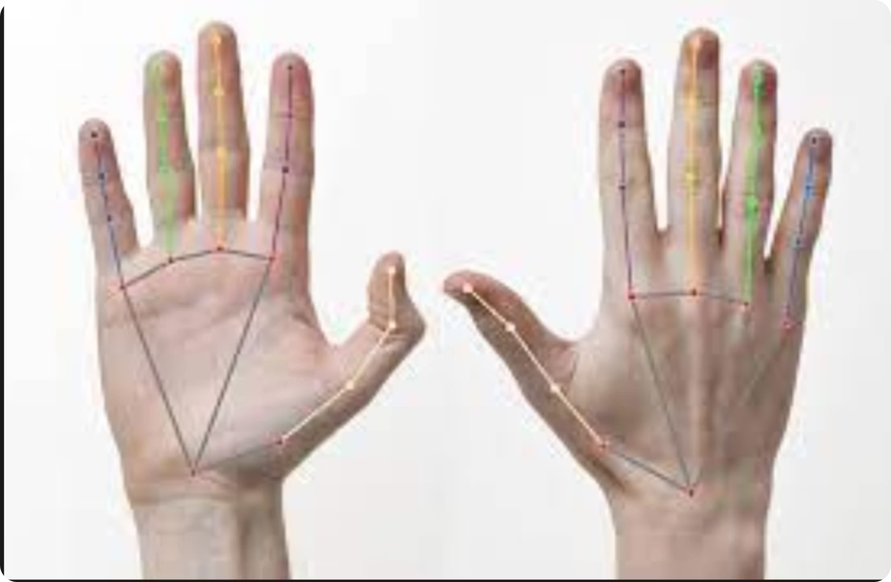
4. Finger Mapping and Gesture Recognition
4.1. Finger Mapping
4.2. Gesture Classification
The paper introduces detection of 36 distinct gestures, comprising the full alphabet and digits. Finger mapping is implicitly handled by the neural network's learning process through convolutional filters in the CNN backbone. It doesn't use manual joint mapping like MediaPipe or hand skeleton APIs.
A transfer learning approach with SSD MobileNet V2 is used to recognize static hand gestures. This model is lightweight and suitable for real-time applications. The trained classifier identifies hand positions and maps them to corresponding alphanumeric labels.

Slide 6
5. Hand Labelling and Dataset Preparation
5.1. Basic Hand Labelling
5.2. Dataset Quality
The dataset was custom-built using webcam snapshots. Each hand gesture was manually labeled and categorized into folders based on the symbol (e.g., 'A', 'B', ..., 'Z', '0'-'9'). The labeling process is crucial in supervised learning, ensuring accurate training.
The dataset consists of over 36 classes with multiple images each, captured under varying light and angle conditions. However, the accuracy reported (70–80%) indicates room for improvement in diverse environmental conditions.
6. Strengths and Limitations

Slide 7





Strengths
No external hardware
Real-time performance
No need for external hardware (e.g., gloves, depth cameras)
Real-time performance using OpenCV and TensorFlow
Budget-conscious
Indian Sign Language
Suitable for budget-conscious users
Focused on Indian Sign Language (ISL)

Slide 8
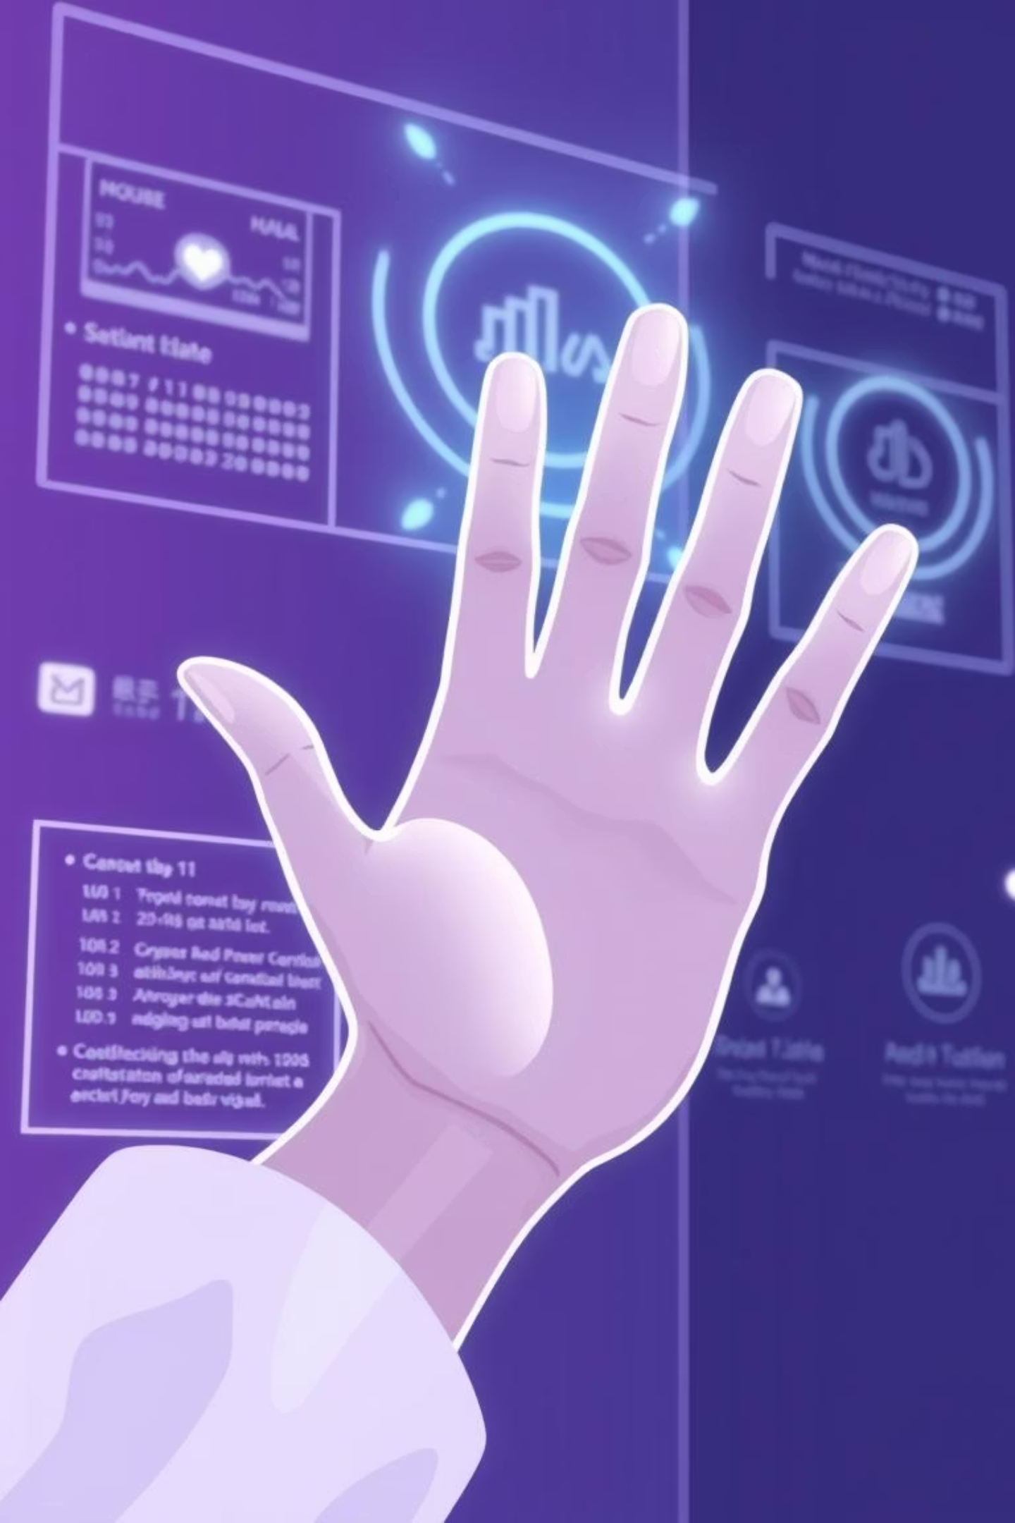
7. Conclusion
The reviewed system presents a promising approach to cost-effective sign language recognition using basic computer vision and deep learning. Its reliance on contrast, clear backgrounds, and consistent hand visibility makes it a strong starting point for accessible assistive communication tools. Future work should explore dynamic gesture recognition, hand skeleton tracking, and environment-independent detection.

